Slide 1
Radiometry of Image Formation
Jitendra Malik

Slide 2

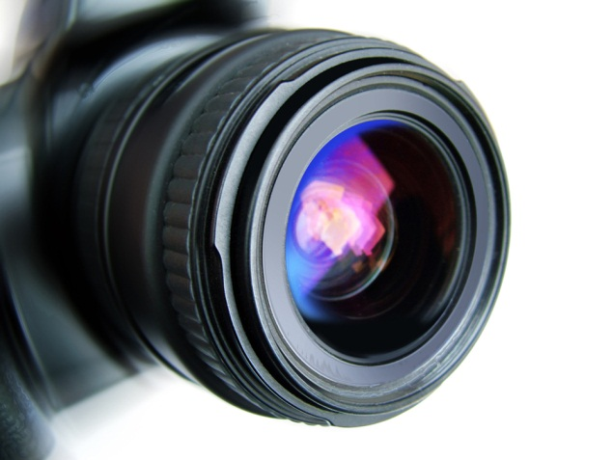

A camera creates an image …
The image I(x,y) measures how much light is captured at pixel (x,y)
We want to know
Where does a point (X,Y,Z) in the world get imaged?
What is the brightness at the resulting point (x,y)?

Slide 3
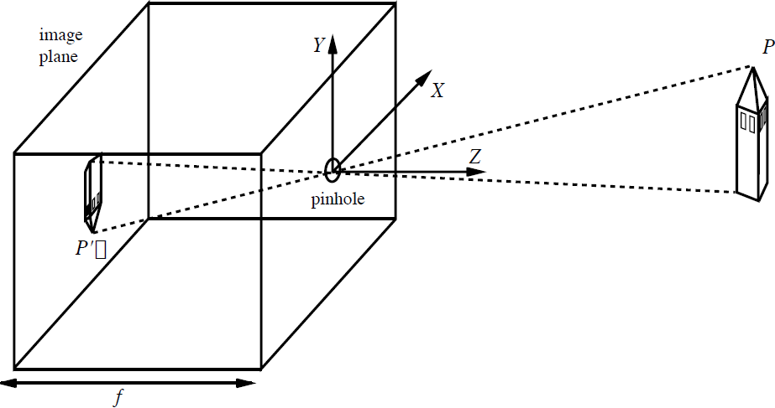




The pinhole camera models where a scene point is projected
y
x

Slide 4

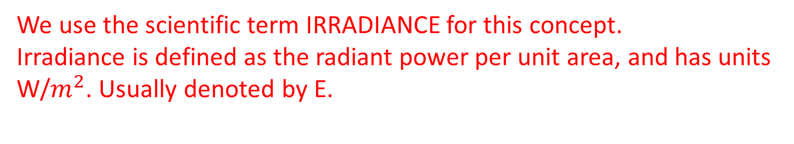
Now let us try to understand brightness at a pixel (x,y) …
The image I(x,y) measures how much light is captured at pixel (x,y). Proportional to the number of photons captured at the sensor element (CCD/CMOS/Rod/cone/..) in a time interval.

Slide 5




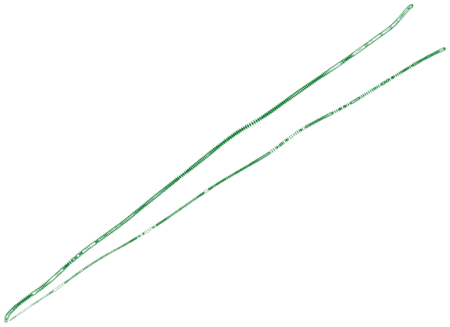
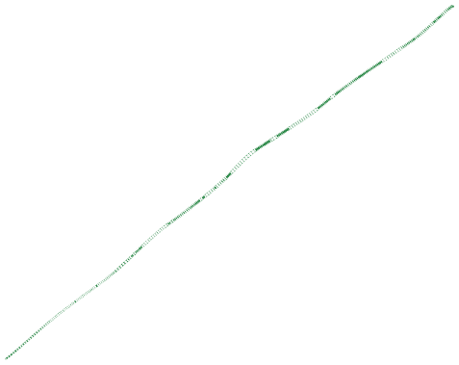

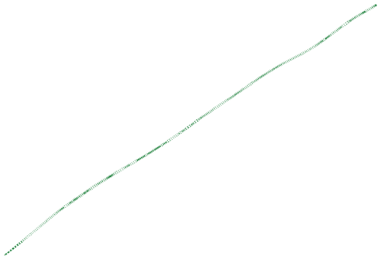




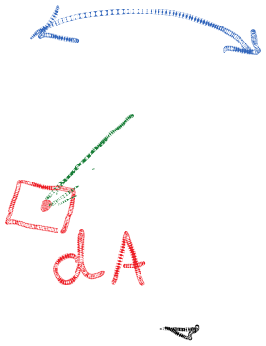
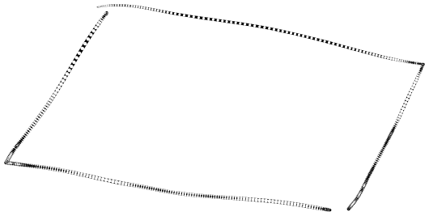
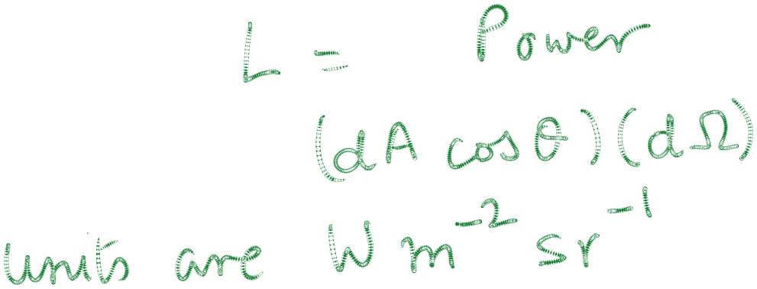
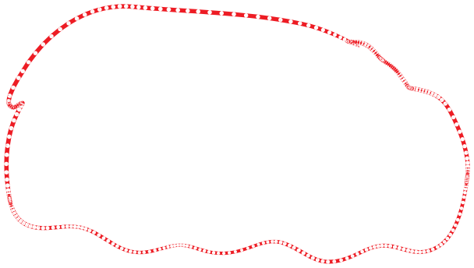

Radiance is a directional quantity
Radiant power travelling in a given direction per unit area (measured perpendicular to the direction of travel) per unit solid angle

Slide 6


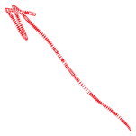

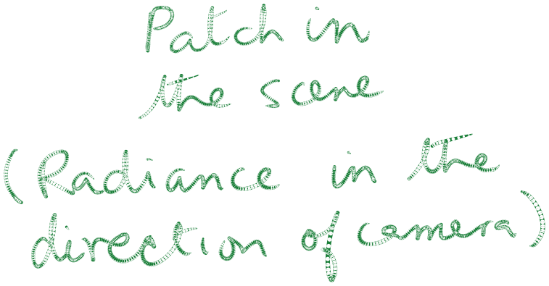

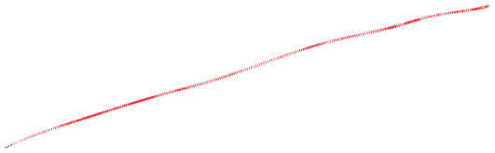
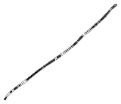
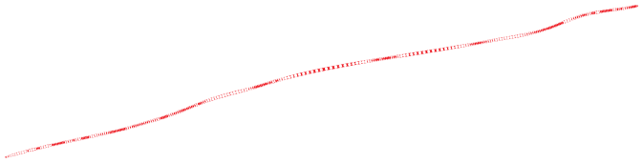
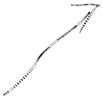
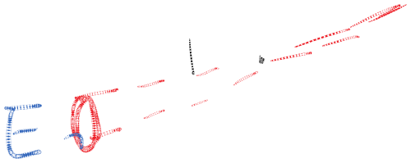
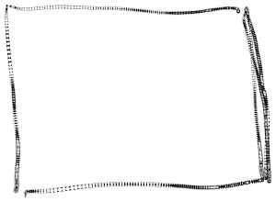
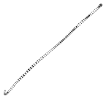

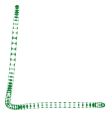
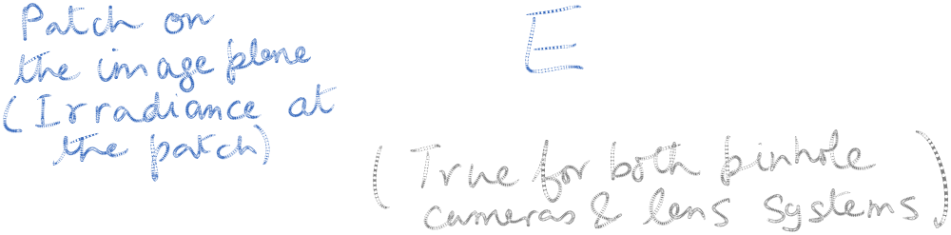

Image irradiance is proportional to scene radiance in the direction of the camera

Slide 7
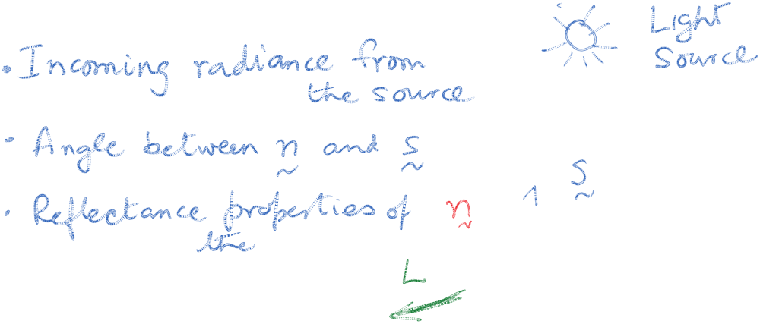
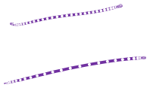
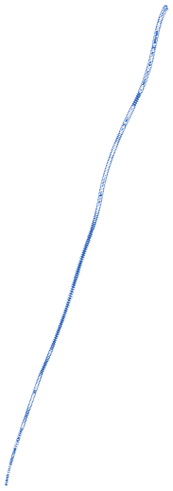



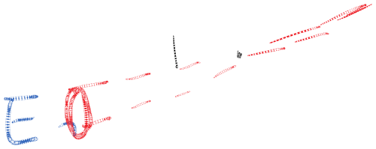
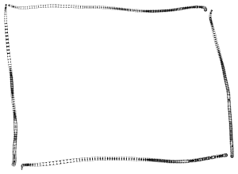
What causes the outgoing radiance at a scene patch?

Slide 8
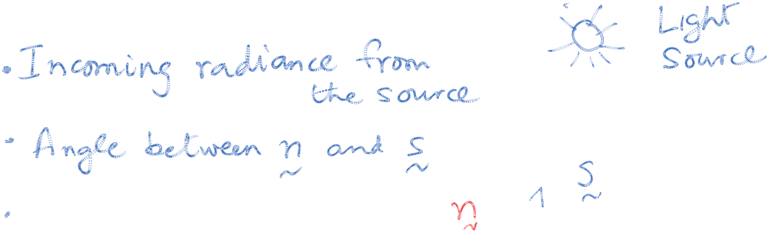




What causes the outgoing radiance at a scene patch?
Two special cases:
Specular surfaces - Outgoing radiance direction obeys angle of incidence=angle of reflection, and co-planarity of incident & reflected rays & the surface normal.
Lambertian surfaces - Outgoing radiance same in all directions

Slide 9
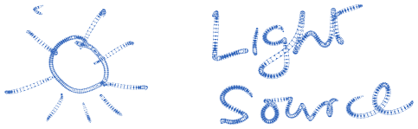
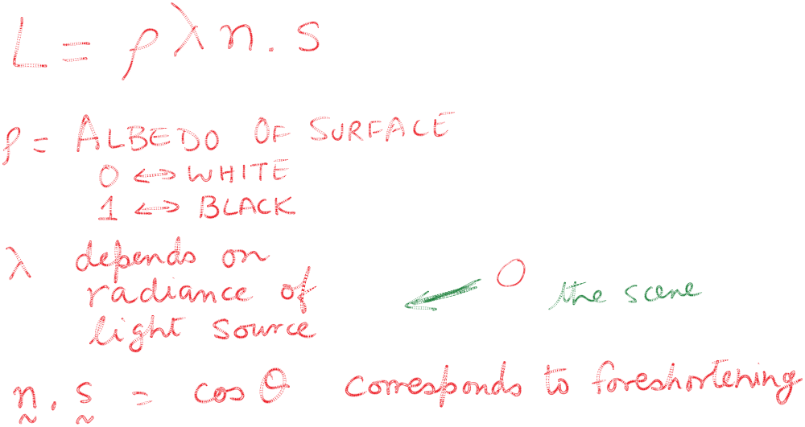

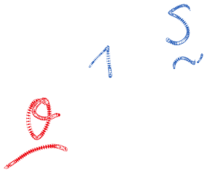
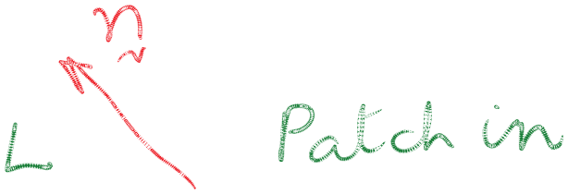
The Lambertian model
We often model reflectance by a combination of a Lambertian term and a specular term. If we want to be precise, we use a BRDF (Bidirectional Reflectance Distribution function) which is a 4D function corresponding to the ratio of outgoing radiance in a particular direction to the incoming irradiance in some other direction. This can be measured empirically.

Slide 10
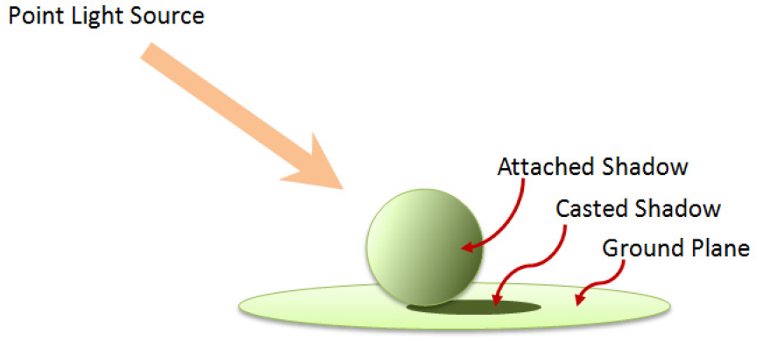
Real world scenes have additional complexity…
Objects are illuminated not just by light sources, but also by reflected light from other surfaces. In computer graphics, ray tracing and radiosity are techniques that address this issue.
Shadows

Slide 11
Inverting the physics of image formation is hard
Shape-from-shading (SFS) seeks to go from the measured irradiance values in the image to the scene geometry, reflectances and illumination that caused it.
This is the inverse of the computer graphics rendering problem where the goal is to produce the image, given the scene.
The inverse problem is much harder than the forward problem; traditional SFS only works under gross simplifying assumptions on the physics.
Computer vision has been much more successful in exploiting the geometry of image formation with multiple views.

